Slide 1
Music Theory
Chapter 1-Part 1
APMT
Hunter Mason

Slide 2
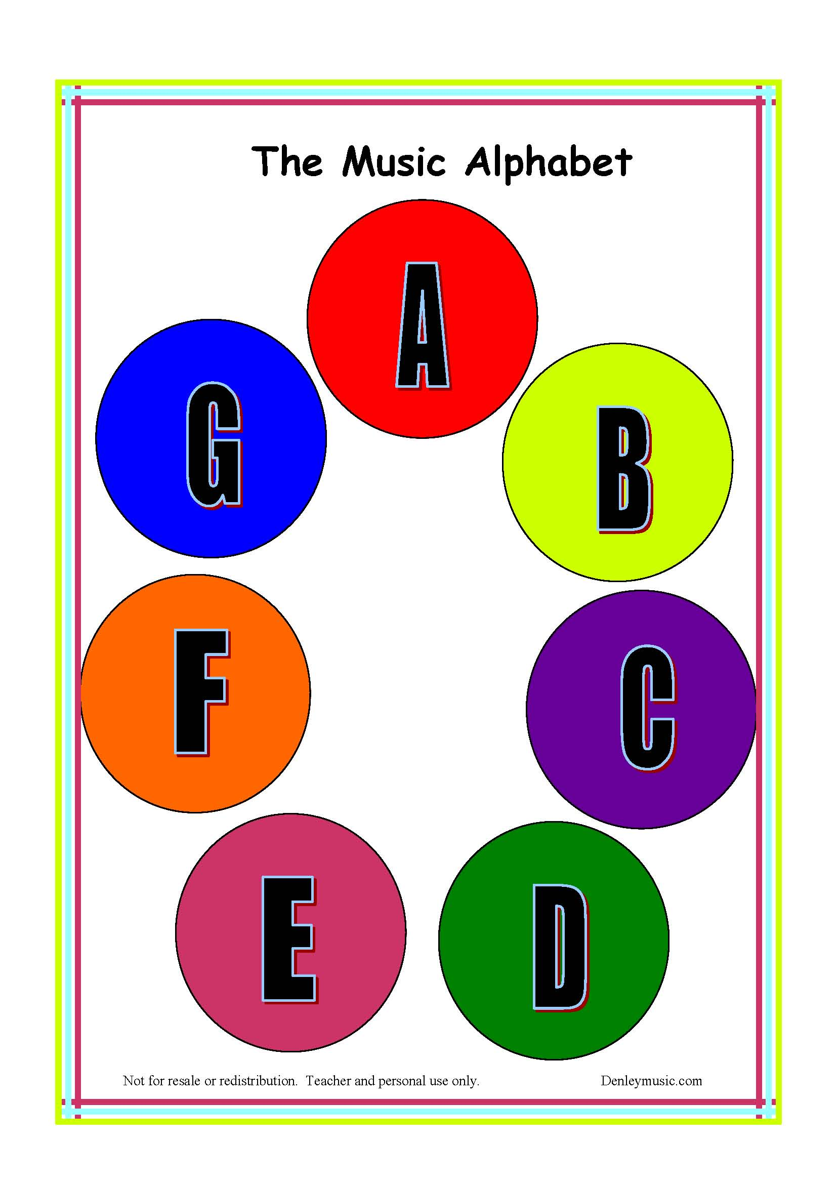
Pitch: Letter Names
Musical notes are named with the first seven letters of the alphabet.
A-B-C-D-E-F-G-A

Slide 3
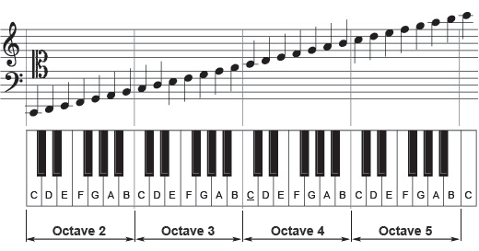
Pitch Class
As the musical alphabet repeats a letter every eighth position to form octaves, you also form a pitch class. A pitch class refers to every instance within an octave where a certain pitch. occurs.

Slide 4
Piano Keys
Each white key on the piano corresponds to a letter in the musical alphabet. The black keys are named in relation to the white keys beside them. For example, a C# is the black key to the right of the C key, and a Bb is the black key to the left of the B key.
Intervals
The distances between notes on the piano are known as intervals. The two most important intervals that build the rest of the intervals we know are the half-step and whole step. Most whole steps are from a white key to another or a black key to another. While most half-steps are from a white key to a black key or the other way around. The only things that break this rule are the natural half-steps of E-F and B-C.
Piano Keys
Enharmonics
If you notice, all the black have two different names on them. This is because there are two equivalent ways to write that certain note. Those notes are enharmonic, which basically means they are synonyms.

Slide 5
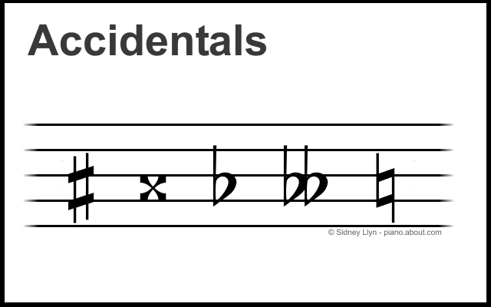
Accidentals
Despite their name, accidentals are used quite purposefully. There are three main types of accidentals: A Flat, b, which lowers a note half a step, A Sharp, #, which raises a note half a step, and a natural , ♮, which cancels out the effects of any previous accidentals. There are also the uncommon double sharp, 𝄪, and double flat, 𝄫, which do their respective raising and lowering by two half-steps.

Slide 6
Activity: Human Piano

