Slide 1
Chapter 3: Pitch Collections, Scales, and Major Keys
By Sarah and Morgan

Slide 2
Chromatic and Diatonic
Chromatic scales are comprised of 12 tones that are all a half-step apart
Diatonic scales are comprised of 7 tones with strategically whole and half-steps. (These are common major scales.)
If there are no guidelines given you can any order of CAGBFED

Slide 3
Scales: Ordered pitch class collection
A pitch class is a set of notes that are all an octave apart. For example, pitch class C contains the notes C1, C2, C3, C4, and C5.
A scale is an ordered pitch collection.
A chromatic scale is entirely of consecutive half steps in the order of the musical alphabet.
When given a pitch, it provides the foundation for a special type of diatonic collection called a major scale.

Slide 4
Scale degrees
The word scale is derived from the latin word “stair” or “ladder”
Each pitch is a scale step, and the number according to the order of it’s placement in the scale is the scale degree.
For example: The scale degree for the note C in C major is 1.
Scale degrees are written with a caret above them.

Slide 5
Spelling Major Scales
It is quite simple just by using the english alphabet…
M-A-J-O-R = major
S-C-A-L-E-S = scales

Slide 6
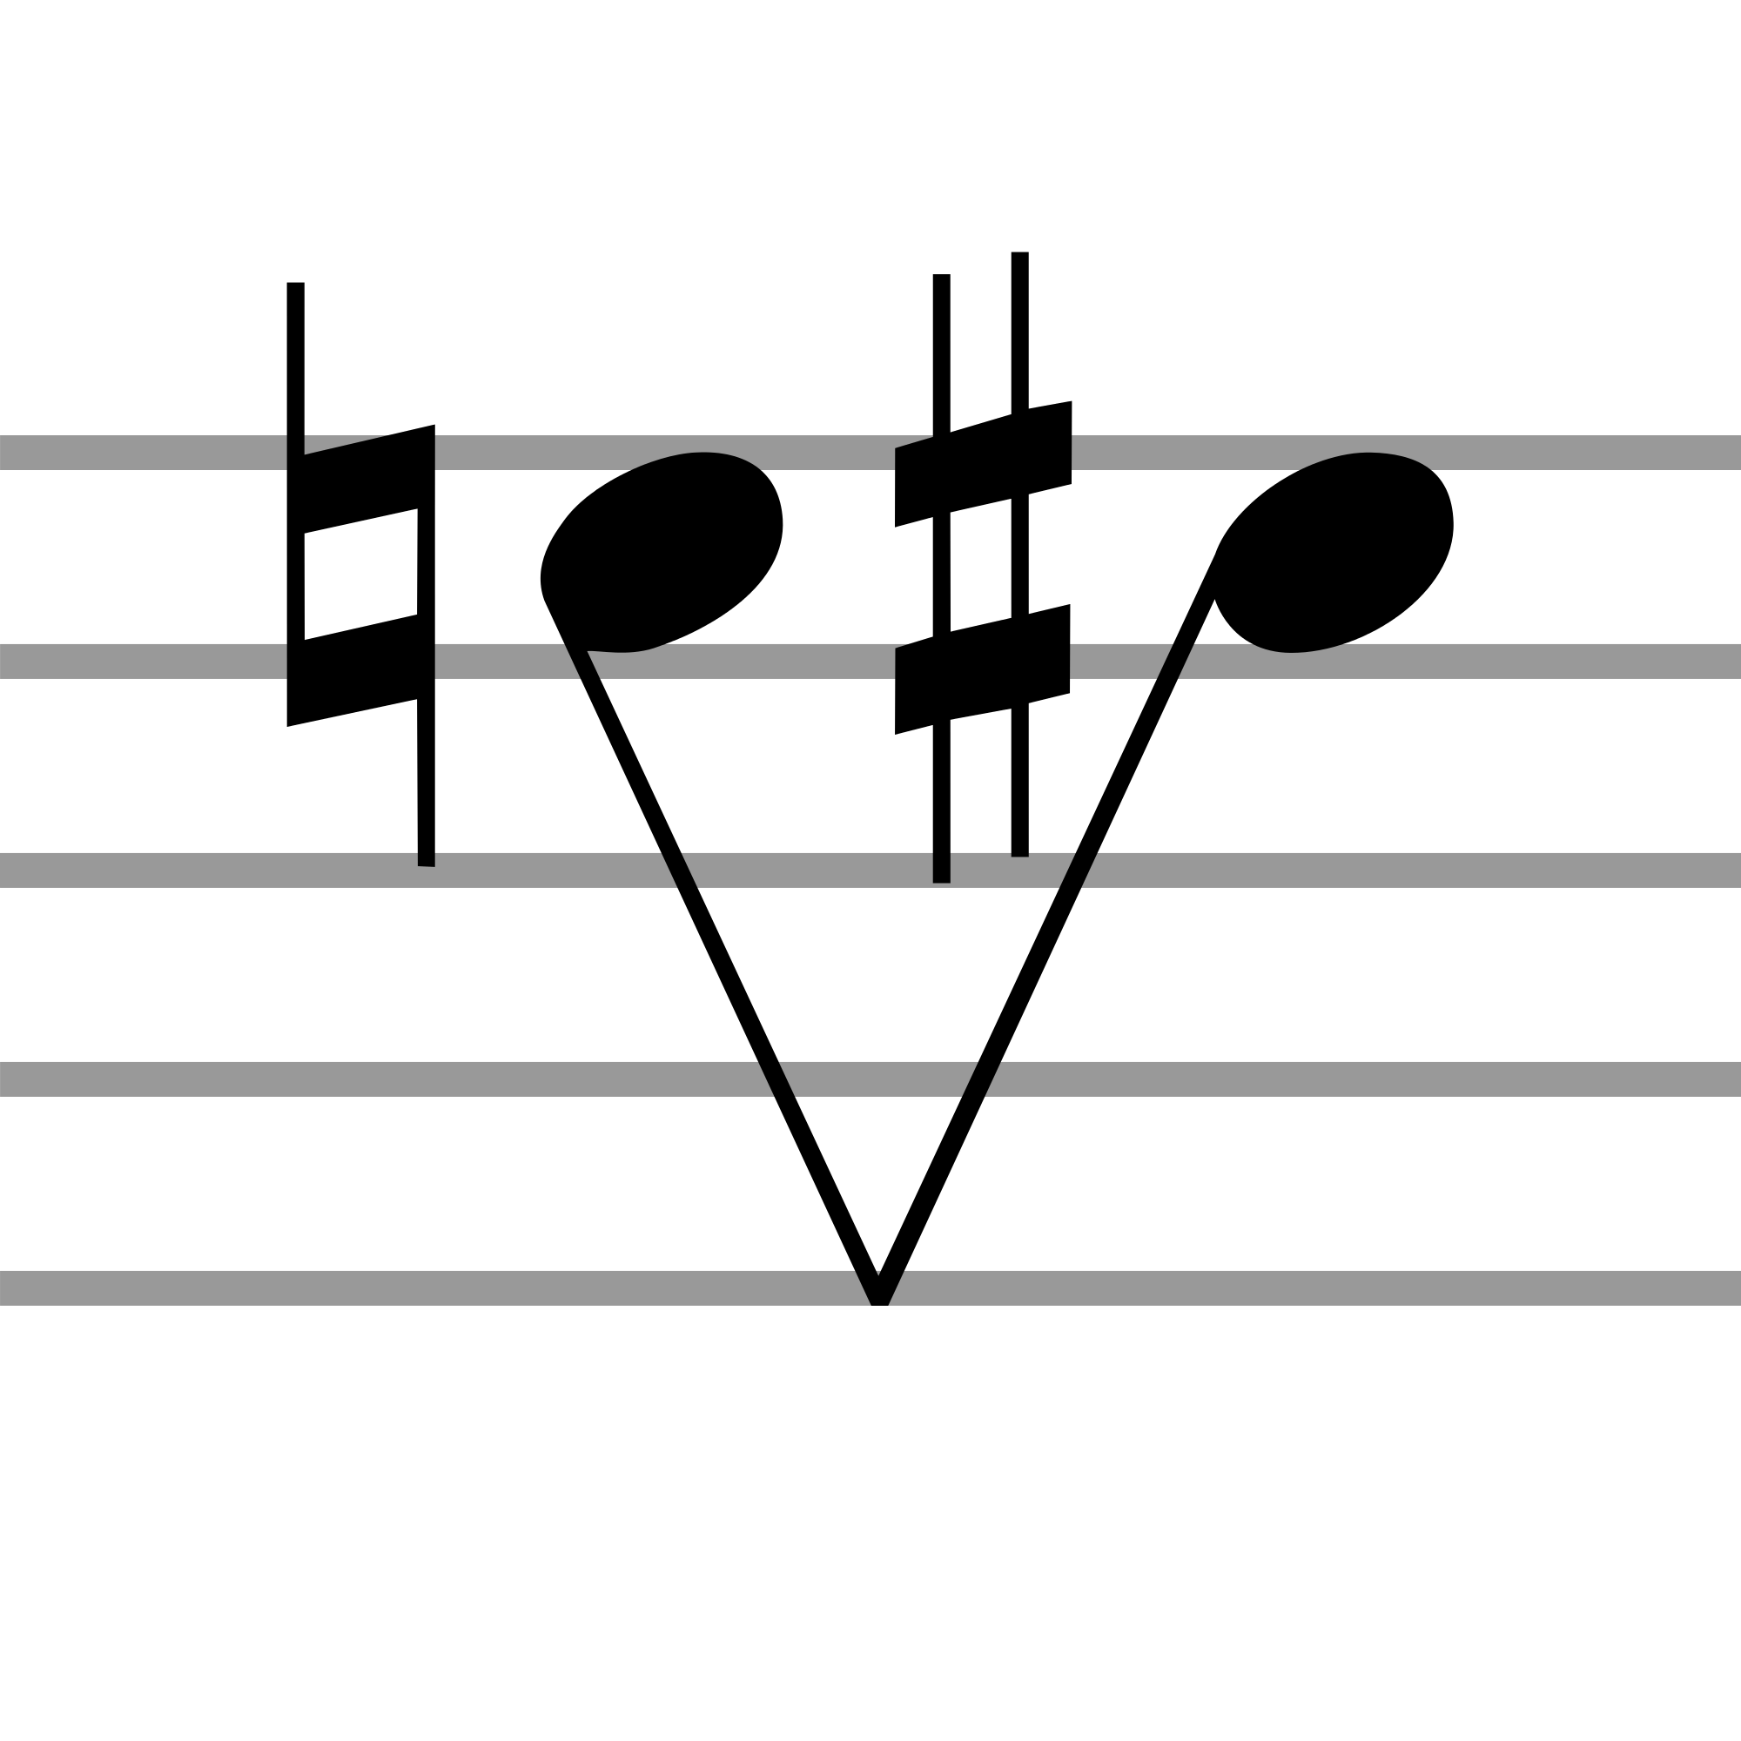
How to Actually Spell Major Scales...
You can write out any major scale if given a pitch, you can use the formula of steps that must be written.
Whole-Whole-Half-Whole-Whole-Whole-Half (WWHWWWH)
When writing in the half steps you may add in accidentals as needed.
Sharp accidental
Flat accidental
lol

Slide 7
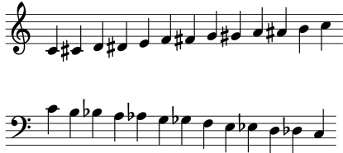
Spelling Chromatic Scales
Chromatic scales can be notated in one of two ways.
When no key is specified, simply raise them a half step when ascending, and lower them when descending.

Slide 8
If a key is specified
First write the underlying major scale in whole notes.
Fill in each whole step with a chromatic half-step
Raise them with a flat or a natural going up or lower them with a flat or natural going down.

Slide 9
Major Keys
When first starting out in music theory, people usually only add accidentals when needed.
In tonal music this is not standard practice.
To shorthand this, you add key signatures at the beginning of the score to specify the consistent accidentals for the rest of the piece.
If you don’t want to “accidental”-ly miss your accidental, then the use of this strategy is the “key” to success.

Slide 10
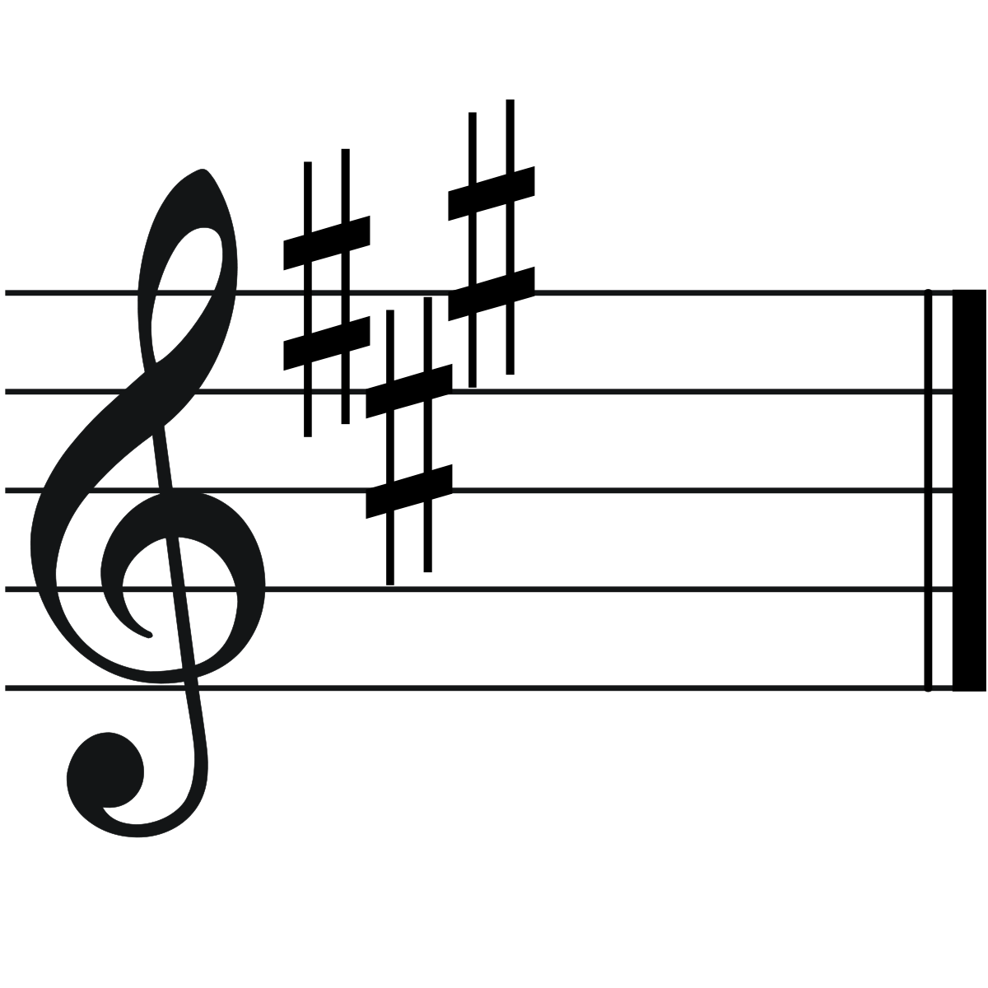
Key Signatures
Instead of putting accidentals in front of each note in a scale, we use a shorthand notation. It is put at the beginning of the score to specify consistent accidentals for the entire piece.
This is an example of a key signature. The notes F, C, and G are all going to be affected by the key signature and make those notes sharp.

Slide 11
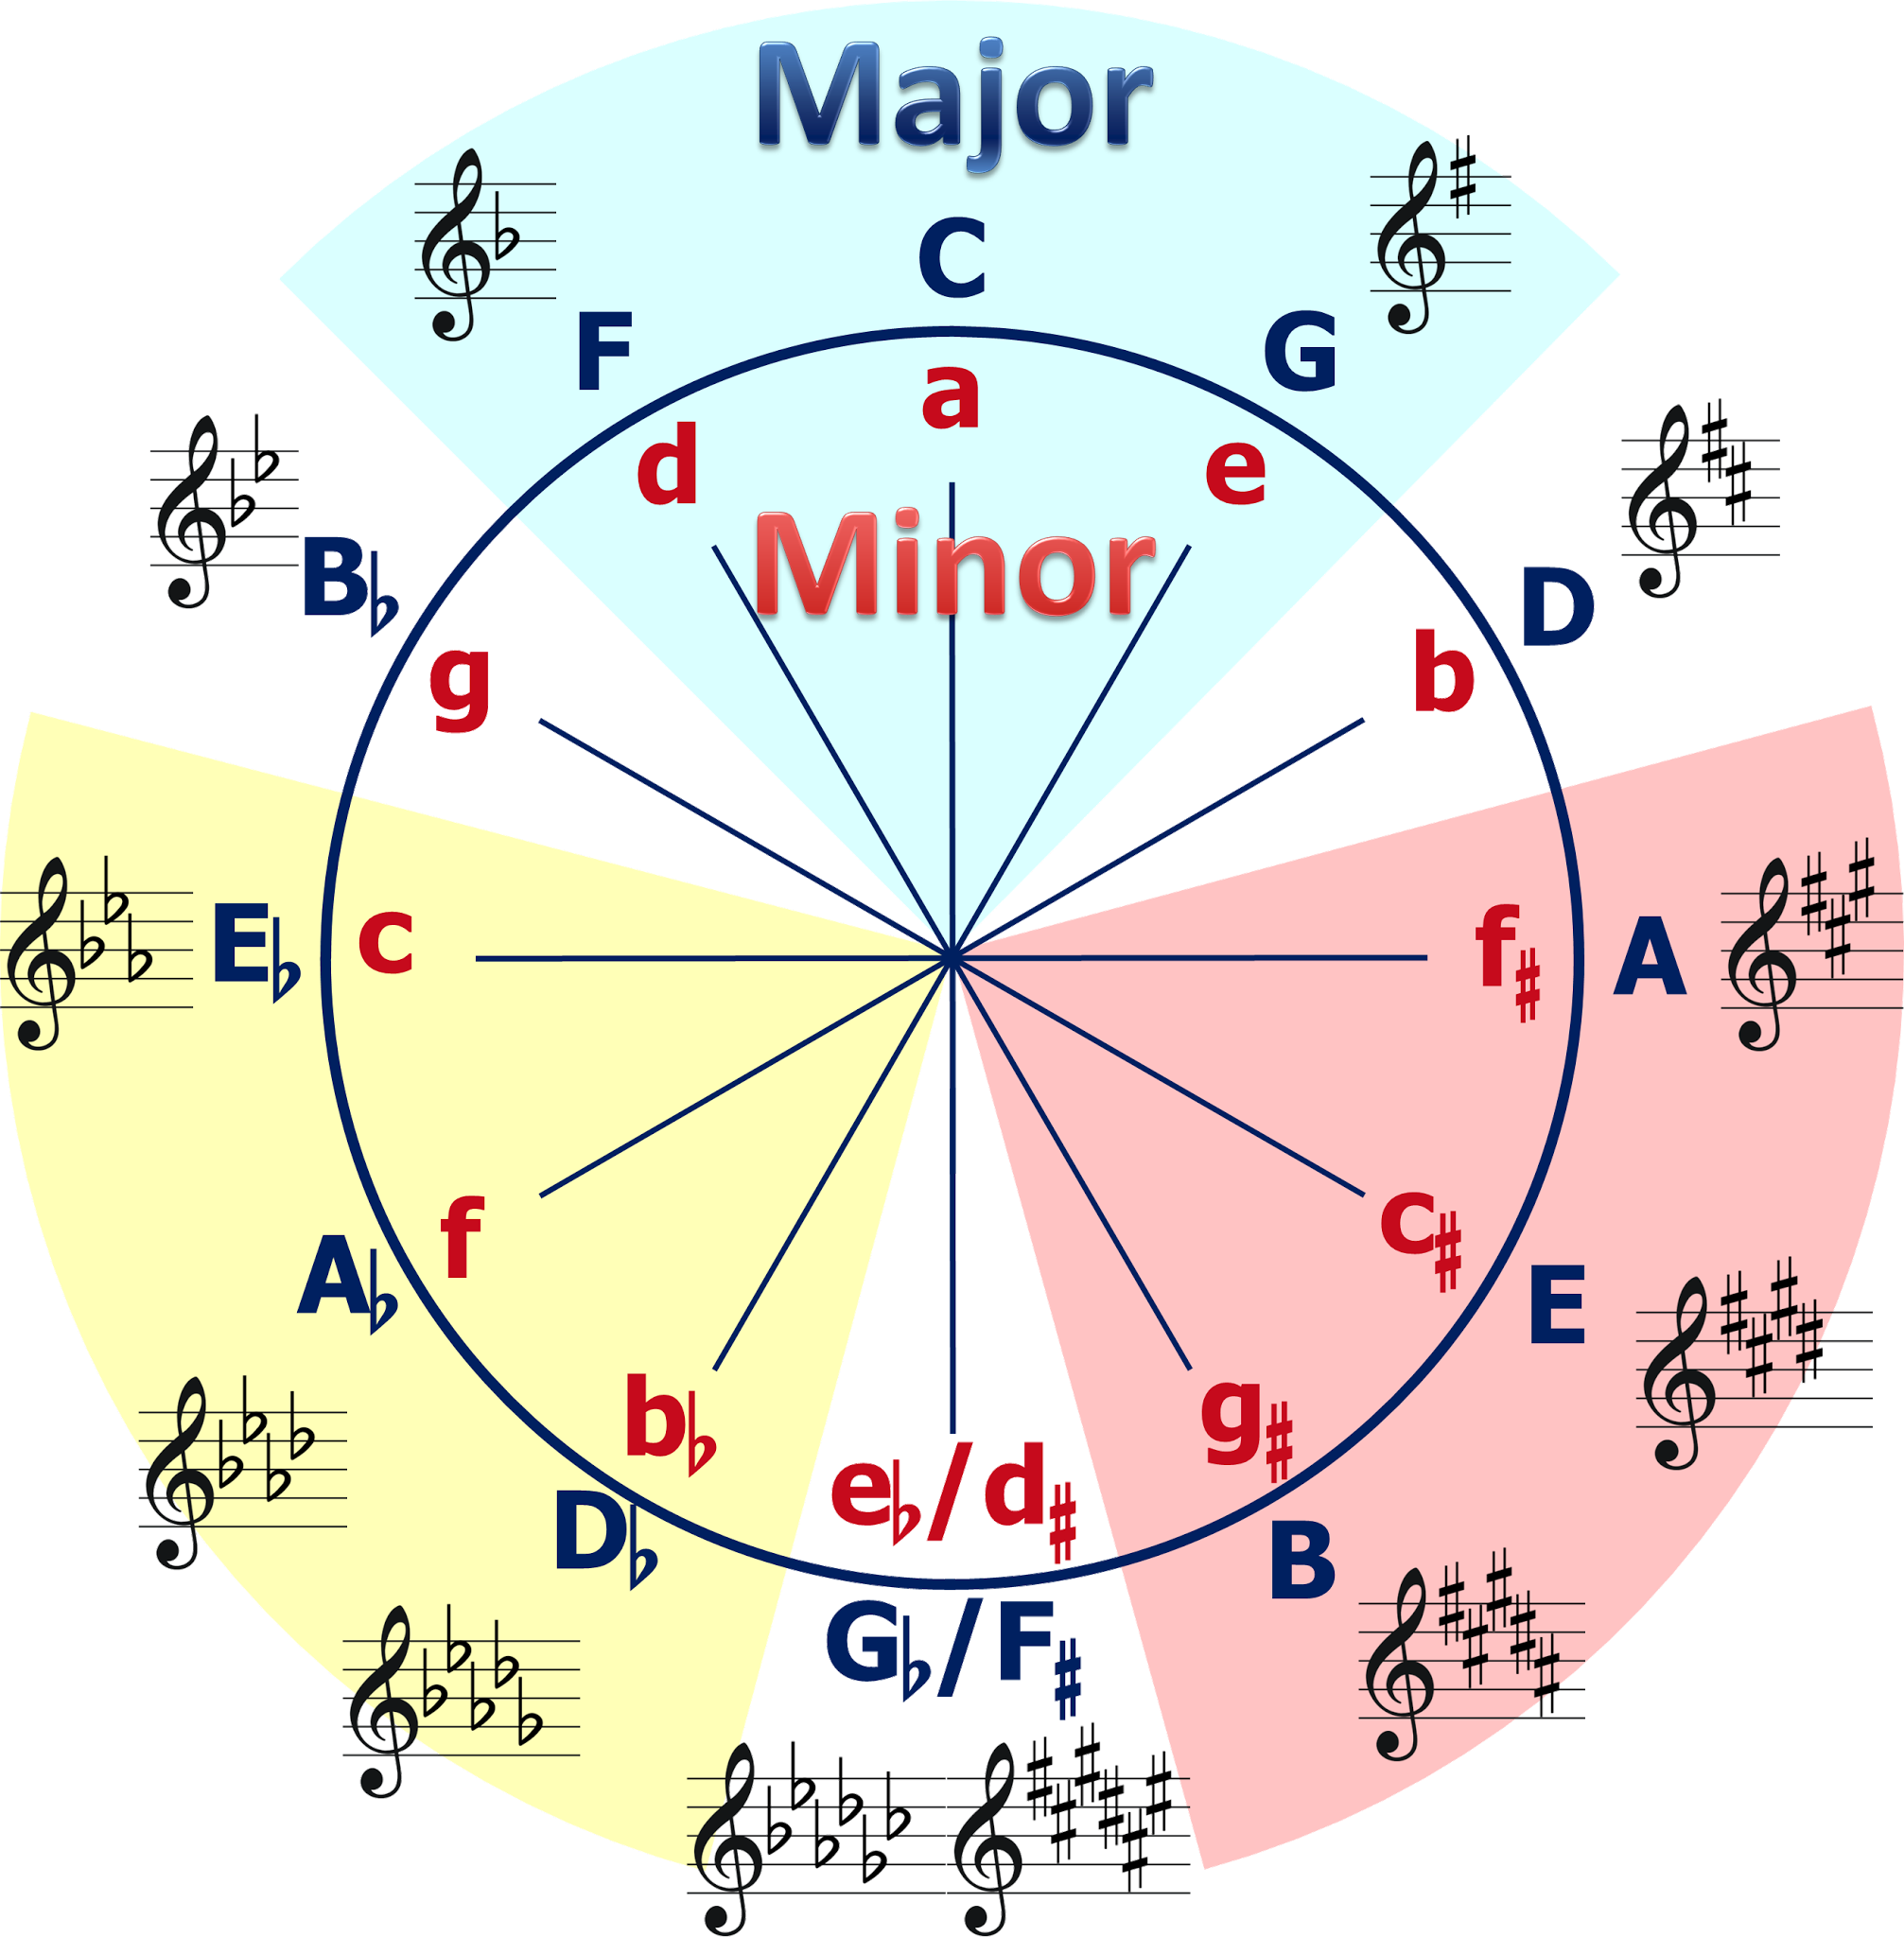
Circle of Fifths

Slide 12
Identifying key signatures
You can calculate the name of the key from the key signature.
For sharp keys, the name of the scale is one half step up from the last flat.
For flat keys, the name of the scale is the next to last flat.

Slide 13
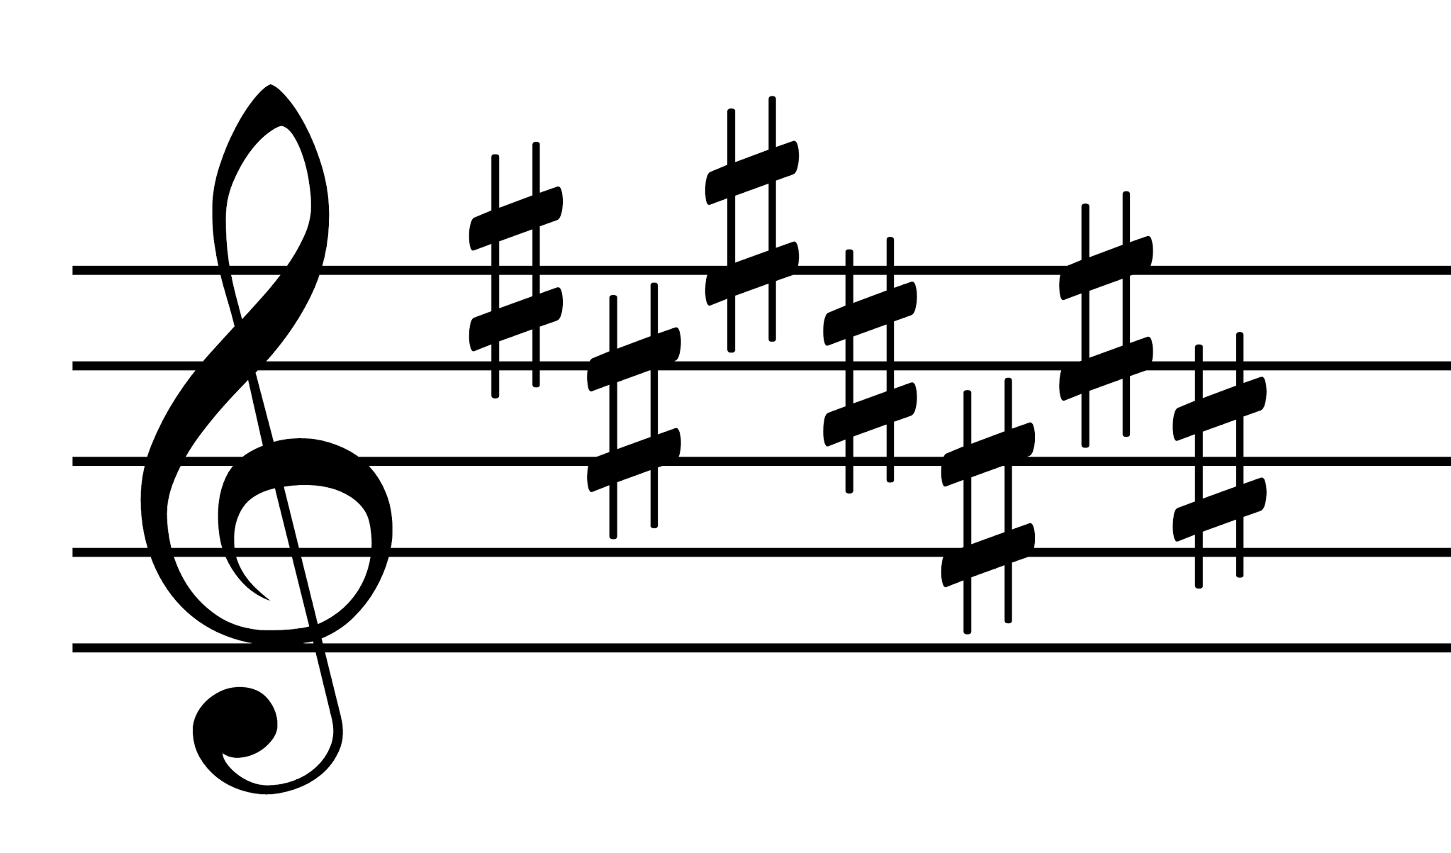
Writing key signatures
There is a certain order for flats and a different order that is used for sharps when writing a key signature.
Order of sharps: FCGDAEB
Order of flats: BEADGCF
Sharps are positioned alternating on the staff going “down-up” and flats alternate going “up-down”.

Slide 14
Identifying the key of a piece
The key signature alone is not enough to identify the key of a piece.
While reading a piece, which just for example, let’s say has one flat in it’s key signature, indicating a piece in F major. However, in the beginning and end of the piece has a heavy emphasis on the note D. This indicates the likely-hood of the piece being in d minor.

Slide 15
Scale Degree Names
In addition to actual numbers, scale degrees also have names.
These can either identify scale degrees themself or harmonies built on it.
1 is the tonic. This is the tone that the scale is built on.
2 is the supertonic. Super means above. It is positioned right above the tonic.
3 is the mediant. Falls between 1 and 5, the “medial” position.
4 is subdominant. Sub- means below. It is positioned below the dominant.
5 is dominant. This function dominates the tonal music.
6 is submediant. Three steps below the tonic.
7 is the leading tone. Tends to lead up to the tonic.

Slide 16
The Major Pentatonic Scale
This scale only includes only five of the seven diatonic pitches.
The scale is missing the 4th and 7th degrees.

Slide 17
Implications for performance
What are your scales for?
Practicing scales on an instrument help to gain finger facility in different keys. This should help for ease when playing scale-like passages.
This can also help with memorization and improvisation, especially when melodies only use the first five scale degrees; called major pentachord.
Major scales should also be used as an analysis tool. Especially when listening for resolutions. This is using the scale degrees from 7 up to 1.

Slide 18
Good Luck On The Exam!!

