Slide 1
Elements of Music
Music Appreciation Ch. 1

Slide 2
What is music?
What type of sound do you consider to be music?
What about noises?
What types of music do you like?
What music do you appreciate? How is this different from liking music?

Slide 3
Passive listening
Passive listening is done for fun. You may do this while studying or working or doing chores.
Think about some songs you love to listen to. These are examples of passive listening. You probably have many of these!

Slide 4
Active Listening
Active listening is what we will do in this class – this is listening to music with a purpose. You may be asked to identify instruments or style or list reasons why you think the singer/composer wrote the song.
*Term* composer = someone that writes music

Slide 5
Which music do you think you enjoy more?
Active
Or
Passive?

Slide 6
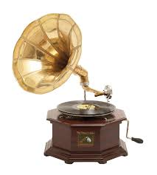
Music Advancements in Tech
Grammaphone!

Slide 7
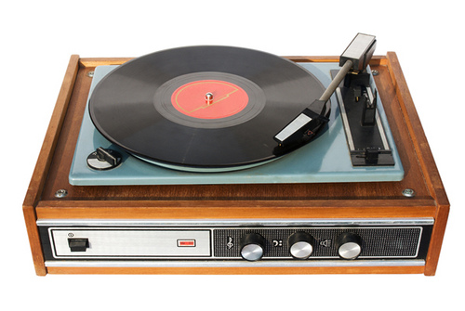
Record players

Slide 8
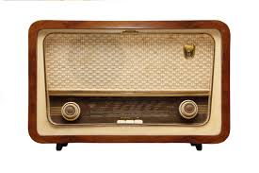
Radio

Slide 9
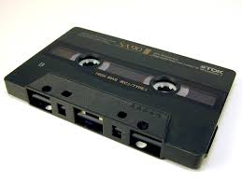
Tapes / Walkman

Slide 10
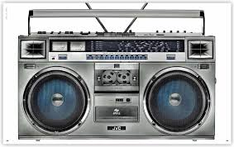
What is a boombox?

Slide 11
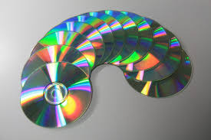
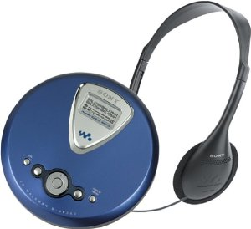
CDs = c________ d_______

Slide 12
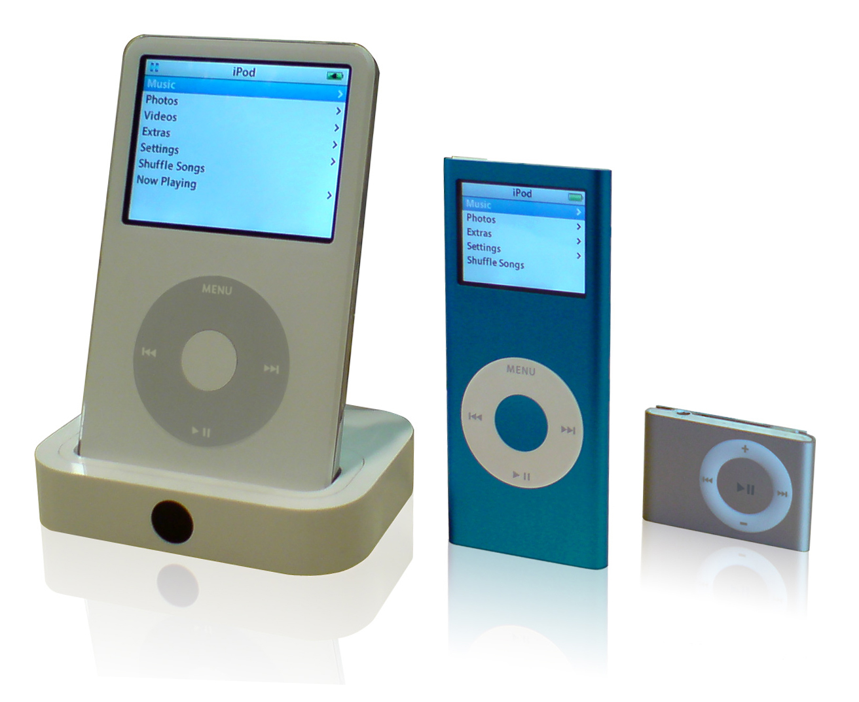
MP3s

Slide 13
Why do we study music?
Part of our lives
Soothes and relaxes us (music therapy)
Allows us to communicate better

Slide 14
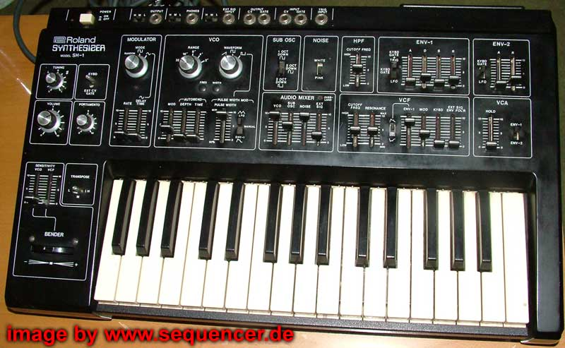
What other advancements?
Synthesizers
Electronics
All can be used in recording and playback / editing.

Slide 15
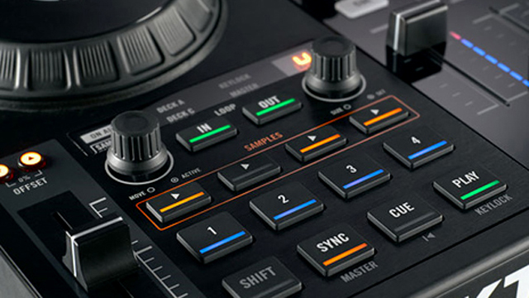
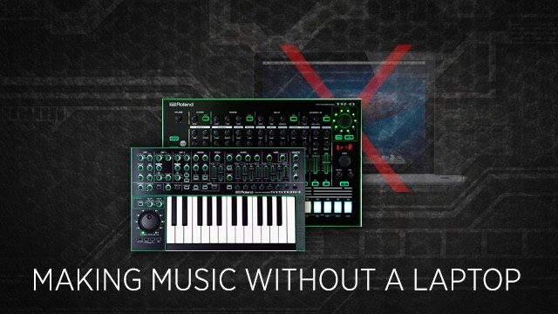
Computers
Computers allow us to create, write, produce, playback, etc.

Slide 16
Six Major Elements
Sound
Harmony
Melody
Rhythm
Form
Words

Slide 17
What is musical sound?
Sound is any output of instruments and voice at any volume.
This also includes timbre (tone).
Ex – “I Wish I Was a Punkrocker” by Sandi Thorn
Ex – “Soul with a Capital S” by Tower of Power

Slide 18
What is musical harmony?
The use of chords (3+ notes) to create depth to music. It can be vocal or instrumental.
Ex – “Hit the Road, Jack” by Ray Charles
Ex – “Twist and Shout” by the Beatles
Ex – “Smoke on the Water” by Deep Purple

Slide 19
What is musical melody?
Music that has range (high/low) and shape (not monotone).
Ex – “Hound Dog” by Elvis Presley
Ex – “Where Did Our Love Go?” by the Supremes

Slide 20
What is musical rhythm?
This is the “heartbeat” of the song. Tempo = the pace of the song and can be fast or slow.
Ex – “Strut” by Sheena Easton

Slide 21
What is musical form?
This is the design of the song. May include verses, chorus, repeats, etc.
Ex – “Blueberry Hill” by Fats Domino

